Slide 1
Rails 3
Present: Ngoc Nguyen

Slide 2
Rails 3
Agenda
1. What is Rails?
2. The MVC Architecture
3. Rails Router
4. Module
5. Helper
6. Associations
7. Active Record Query Interface

Slide 3
Rails 3
1. What is Rails?
Rails is a web application development framework written in the Ruby language
It is designed to make programming web applications easier
It allows you to write less code while accomplishing more than many other languages and frameworks.

Slide 4
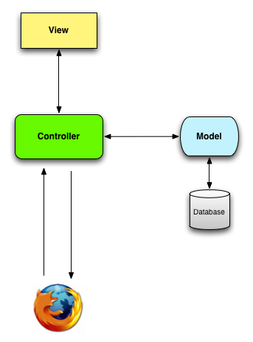
Rails 3
2. The MVC Architecture

Slide 5
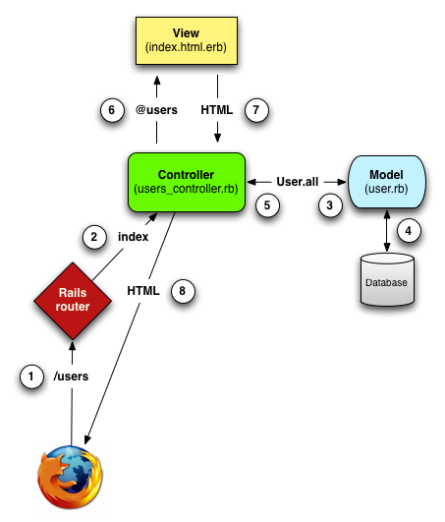
Rails 3
2. The MVC Architecture (detail)

Slide 6
Rails 3
2. The MVC Architecture
Model layer
Represent your domain model (such as Account, Product, Person)
Encapsulate the business logic that is specific to your application
Model classes are derived from ActiveRecord::Base.
View layer
Templates can come in a variety of formats, but most view templates are HTML with embedded Ruby code (.erb files).

Slide 7
Rails 3
2. The MVC Architecture
Controller layer
It is responsible for handling incoming HTTP requests and providing a suitable response
It can also generate XML, JSON, ..
Controllers manipulate models and render view templates in order to generate the appropriate HTTP response

Slide 8
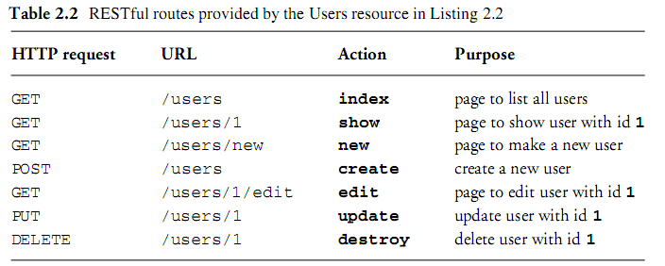
Rails 3
3. Rails Router

Slide 9
Rails 3
3. Rails Router
The Rails router recognizes URLs and dispatches them to a controller’s action
It can also generate paths and URLs, avoiding the need to hardcode strings in your views

Slide 10
Rails 3
4. Module
Characteristic
Like classes, modules are bundles of methods and constants.
Unlike classes, modules don’t have instances
Instead, modules get mixed in to classes
the instance of the class has the ability to call instance methods defined in the module
When to use Module?
Share code among more than one class

Slide 11
Rails3
5. Helper
A helper file, located in app/helpers, is created automatically for every controller you create
Inside the helper files, you can write arbitrarily many Ruby methods; these methods are automatically accessible in your view template code
If you’re using a construct several times in one or more of your templates, you can write a method that generates the construct, and then call the method from the template.
Rails also supplies you a large number of predefined helper methods. link_to is a perfect example

Slide 12

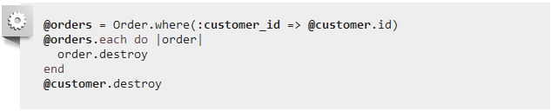
Rails3
6. Associations
a. Why Associations?
Make common operations simpler and easier in your code.
Without associations:

Slide 13
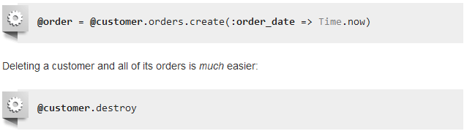
Rails3
6. Associations
a. Why Associations?
With associations:

Slide 14

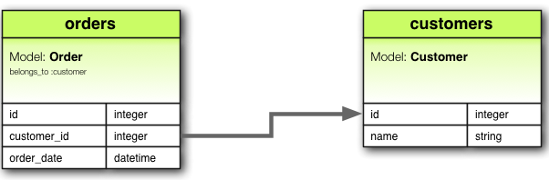
Rails3
6. Associations
b. The Types of Associations
belongs_to: set up a one-to-one connection. For example, if your application includes customers and orders, and each order can be assigned to exactly one customer

Slide 15

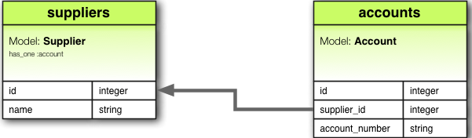
Rails3
6. Associations
b. The Types of Associations
has_one : also sets up a one-to-one connection, but this association indicates that each instance of a model contains or possesses one instance of another model. For example, if each supplier in your application has only one account.

Slide 16

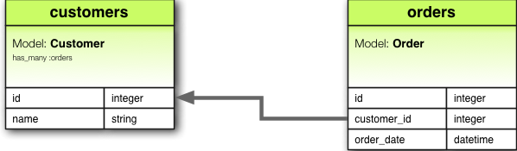
Rails3
6. Associations
b. The Types of Associations
has_many: indicate a one-to-many connection. This association indicates that each instance of the model has zero or more instances of another model

Slide 17
Rails3
6. Associations
b. The Types of Associations
has_many :through: set up a many-to-many connection. This association indicates that the declaring model can be matched with zero or more instances of another model by proceeding through a third model.

Slide 18



Rails3
6. Associations
b. The Types of Associations
has_many :through:

Slide 19
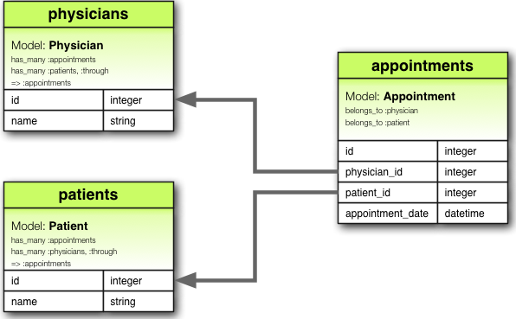
Rails3
6. Associations
b. The Types of Associations
has_many :through:

Slide 20
Rails3
6. Associations
b. The Types of Associations
has_one :through: sets up a one-to-one connection. This association indicates that the declaring model can be matched with one instance of another model by proceeding through a third model.
For example, if each supplier has one account, and each account is associated with one account history

Slide 21
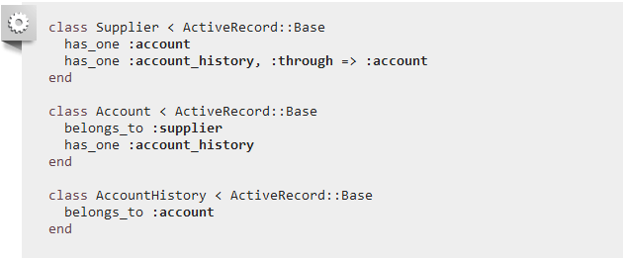
Rails3
6. Associations
b. The Types of Associations
has_one :through:

Slide 22
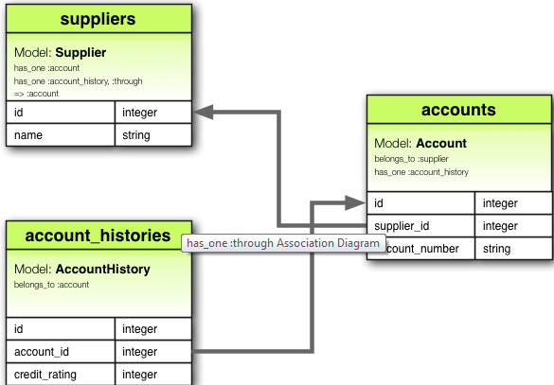
Rails3
6. Associations
b. The Types of Associations
has_one :through:

Slide 23
Rails3
6. Associations
b. The Types of Associations
has_and_belongs_to_many: create a DIRECT many-to-many connection
For example, if your application includes assemblies and parts, with each assembly having many parts and each part appearing in many assemblies

Slide 24
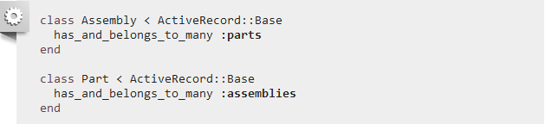
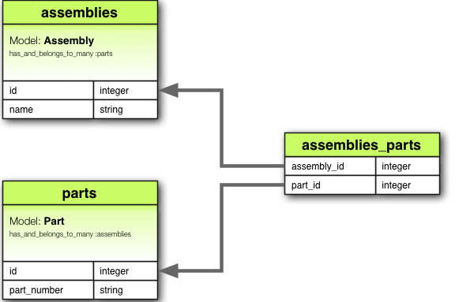
Rails3
6. Associations
b. The Types of Associations
has_and_belongs_to_many: Don’t use this associate instead of has_many

Slide 25
Rails3
7. Active Record Query Interface
a. Retrieving Objects from the Database
select , from, where
group, having
order, reorder, reverse_order
limit, offset
joins, includes, readonly
Refer: http://guides.rubyonrails.org/active_record_querying.html

Slide 26

Rails3
7. Active Record Query Interface
b. Scopes :
Allow you to specify commonly-used queries which can be referenced as method calls on the association objects or models
All scope methods will return an ActiveRecord::Relation object

Slide 27

Rails3
7. Active Record Query Interface
c. default scope :
If we wish for a scope to be applied across all queries to the model we can use the default_scope method within the model itself

Slide 28
Before Refactor
class User < ActiveRecord::Base validates_presence_of :cellphone before_save :parse_cellphone def parse_cellphone # do something end end

Slide 29
After Refactor
module HasCellphone def self.included(base) base.validates_presence_of :cellphone base.before_save :parse_cellphone end def parse_cellphone # do something end end class User < ActiveRecord::Base include HasCellphone end

Slide 30
Helpful Link
Refer:
http://guides.rubyonrails.org/index.html
http://ruby.railstutorial.org/book/ruby-on-rails-tutorial?version=3.0#sec:demo_users_resource
Ruby Doc:
http://www.ruby-doc.org/docs/ProgrammingRuby/
http://www.ruby-lang.org/en/documentation/
You should read:
http://guides.rubyonrails.org/security.html

